Slide 1


Md. Samrat-Uz-Zaman
13/04/2024

Slide 2

Outline
Executive Summary
Introduction
Methodology
Results
Conclusion
Appendix

Slide 3
Executive Summary
Summary of methodologies
The research attempts to identify the factors for a successful rocket landing. To make this determination, the following methodologies where used:
Collect data using SpaceX REST API and web scraping techniques
Wrangle data to create success/fail outcome variable
Explore data with data visualization techniques, considering the following factors: payload, launch site, flight number and yearly trend
Analyze the data with SQL, calculating the following statistics: total payload, payload range for successful launches, and total # of successful and failed outcomes
Explore launch site success rates and proximity to geographical markers
Visualize the launch sites with the most success and successful payload ranges
Build Models to predict landing outcomes using logistic regression, support vector machine (SVM), decision tree and K-nearest neighbor (KNN)
Summary of all results
Exploratory Data Analysis:
Launch success has improved over time
KSC LC-39A has the highest success rate among landing sites
Orbits ES-L1, GEO, HEO, and SSO have a 100% success rate
Visualization/Analytics:
Most launch sites are near the equator, and all are close to the coast
Predictive Analytics:
All models performed similarly on the test set. The decision tree model slightly outperformed

Slide 4
Introduction
Project background and context
SpaceY, a leader in the space industry, strives to make space travel affordable for everyone. Its accomplishments include sending spacecraft to the international space station, launching a satellite constellation that provides internet access and sending manned missions to space. SpaceY can do this because the rocket launches are relatively inexpensive ($62 million per launch) due to its novel reuse of the first stage of its Falcon 9 rocket. Other providers, which are not able to reuse the first stage, cost upwards of $165 million each. By determining if the first stage will land, we can determine the price of the launch. To do this, we can use public data and machine learning models to predict whether SpaceX – or a competing company – can reuse the first stage.
Problems you want to find answers
How payload mass, launch site, number of flights, and orbits affect first-stage landing success
What is the rate of successful landings over time
What is the best predictive model for successful landing (binary classification)

Slide 5

Section 1

Slide 6
Methodology
Executive Summary
Data collection methodology
SpaceX REST API
web scraping techniques
Perform data wrangling
filtering the data
handling missing values
applying one hot encoding
Perform exploratory data analysis (EDA) using visualization and SQL
EDA with SQL
Data visualization techniques
Perform interactive visual analytics using Folium and Plotly Dash
Interactive map with Folium
Interactive dashboard with Plotly Dash
Perform predictive analysis using classification models
Build Models to predict landing outcomes using classification models.
Tune and evaluate models to find best model and parameters

Slide 7
Data Collection
Use SpaceX Rest API
SpaceX data in JSON
Normalize data into csv file
Data to further process
Get HTML response data from Wikipedia
Extract Data using Beautiful soup
Normalize data into csv file

Slide 8
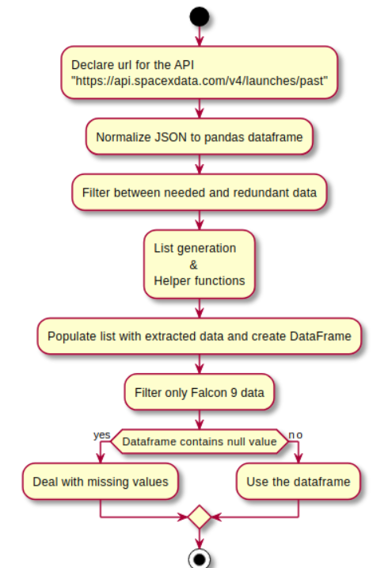
Data Collection – SpaceX API
Data collection with SpaceX REST calls.
1. https://github.com/r-spacex/SpaceX-API
2. https://api.spacexdata.com/v4/rockets/
3. https://api.spacexdata.com/v4/launchpads/
4. https://api.spacexdata.com/v4/payloads/
5. https://api.spacexdata.com/v4/cores/
Github link
https://github.com/saturn-sam/IBM_Data_Science/blob/b0a38417a03b0e22d0f37db279deacf6b7c46b6b/C10/W1/solved-jupyter-labs-spacex-data-collection-api.ipynb

Slide 9
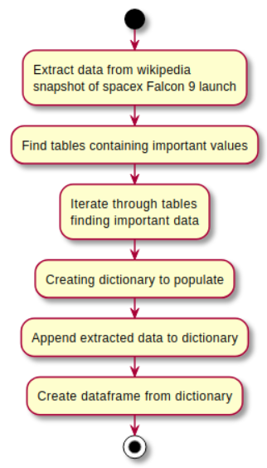
Data Collection - Scraping
Web Scrapping URL
https://en.wikipedia.org/wiki/List_of_Falcon_9_and_Falcon_Heavy_launches
Github URL:
https://github.com/saturn-sam/IBM_Data_Science/blob/b0a38417a03b0e22d0f37db279deacf6b7c46b6b/C10/W1/solved-jupyter-labs-webscraping.ipynb

Slide 10
Data Wrangling
Check Null Values
Calculate the number of launces in each site
Calculate the number of launces in each orbit
Handle null values
Create a landing outcome label from outcome column
Calculate the number of Mission outcome in each orbit type
Github URL:
https://github.com/saturn-sam/IBM_Data_Science/blob/b0a38417a03b0e22d0f37db279deacf6b7c46b6b/C10/W1/solved-labs-jupyter-spacex-Data%20wrangling.ipynb

Slide 11
EDA with Data Visualization
Charts Used:
Flight Number vs. Payload
Flight Number vs. Launch Site
Payload Mass (kg) vs. Launch Site
Payload Mass (kg) vs. Orbit type
EDA with Visualization Analysis
View relationship by using scatter plots. The variables could be useful for machine learning if a relationship exists
Show comparisons among discrete categories with bar charts. Bar charts show the relationships among the categories and a measured value.
Github URL:
https://github.com/saturn-sam/IBM_Data_Science/blob/b0a38417a03b0e22d0f37db279deacf6b7c46b6b/C10/W2/solved-edadataviz.ipynb

Slide 12
EDA with SQL
SQL Query Performed
Displaying the names of the unique launch sites in the space mission
Displaying 5 records where launch sites begin with the string 'KSC'
Displaying the total payload mass carried by boosters launched by NASA (CRS)
Displaying average payload mass carried by booster version F9 v1.1
Listing the date where the successful landing outcome in drone ship was achieved.
Listing the names of the boosters which have success in ground pad and have payload mass greater than 4000 but less than 6000
Listing the total number of successful and failure mission outcomes
Listing the names of the booster_versions which have carried the maximum payload mass.
Listing the records which will display the month names, successful landing_outcomes in ground pad, booster
versions, launch_site for the months in year 2017
Ranking the count of successful landing_outcomes between the date 2010 06 04 and 2017 03 20 in descending order.
Github URL:
https://github.com/saturn-sam/IBM_Data_Science/blob/b0a38417a03b0e22d0f37db279deacf6b7c46b6b/C10/W2/solved-jupyter-labs-eda-sql-coursera_sqllite.ipynb

Slide 13
Build an Interactive Map with Folium
Markers Indicating Launch Sites
Added blue circle at NASA Johnson Space Center's coordinate with a popup label showing its name using its latitude and longitude coordinates
Added red circles at all launch sites coordinates with a popup label showing its name using its name using its latitude and longitude coordinates Map with Folium
Colored Markers of Launch Outcomes
Added colored markers of successful (green) and unsuccessful (red) launches at each launch site to show which launch sites have high success rates
Distances Between a Launch Site to Proximities
Added colored lines to show distance between launch site CCAFS SLC- 40 and its proximity to the nearest coastline, railway, highway, and city
Github URL:
https://github.com/saturn-sam/IBM_Data_Science/blob/b0a38417a03b0e22d0f37db279deacf6b7c46b6b/C10/W3/solved-lab_jupyter_launch_site_location.ipynb

Slide 14
Build a Dashboard with Plotly Dash
Dropdown List with Launch Sites
Allow user to select all launch sites or a certain launch site
Slider of Payload Mass Range
Allow user to select payload mass range
Pie Chart Showing Successful Launches
• Allow user to see successful and unsuccessful launches as a percent of the total
Scatter Chart Showing Payload Mass vs. Success Rate by Booster Version
• Allow user to see the correlation between Payload and Launch Success
Github URL:
https://github.com/saturn-sam/IBM_Data_Science/blob/b0a38417a03b0e22d0f37db279deacf6b7c46b6b/C10/W3/spacex_dash_app.py

Slide 15
Predictive Analysis (Classification)
Prepare data
Create a column for the class
Standardize the data
Split into training data and test data
Define model and parameters
Train and Grid Search for best parameters
Evaluation
Preprocess Data
Define Model
Train Model
Evaluate Model
Data Cleaning
Choose Model
Tune Model
Accuracy Analysis
Model Plot
Grid Search
Model Parameters
Data Transformation
Dataset Splitting
Github Link:
https://github.com/saturn-sam/IBM_Data_Science/blob/b0a38417a03b0e22d0f37db279deacf6b7c46b6b/C10/W4/SpaceX_Machine%20Learning%20Prediction_Part_5.ipynb

Slide 16
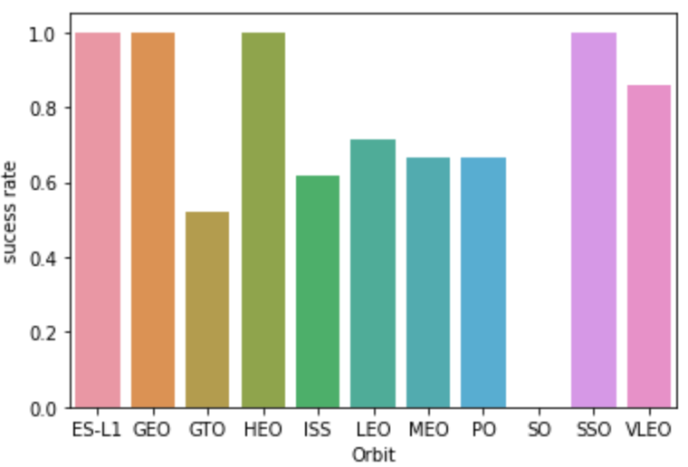
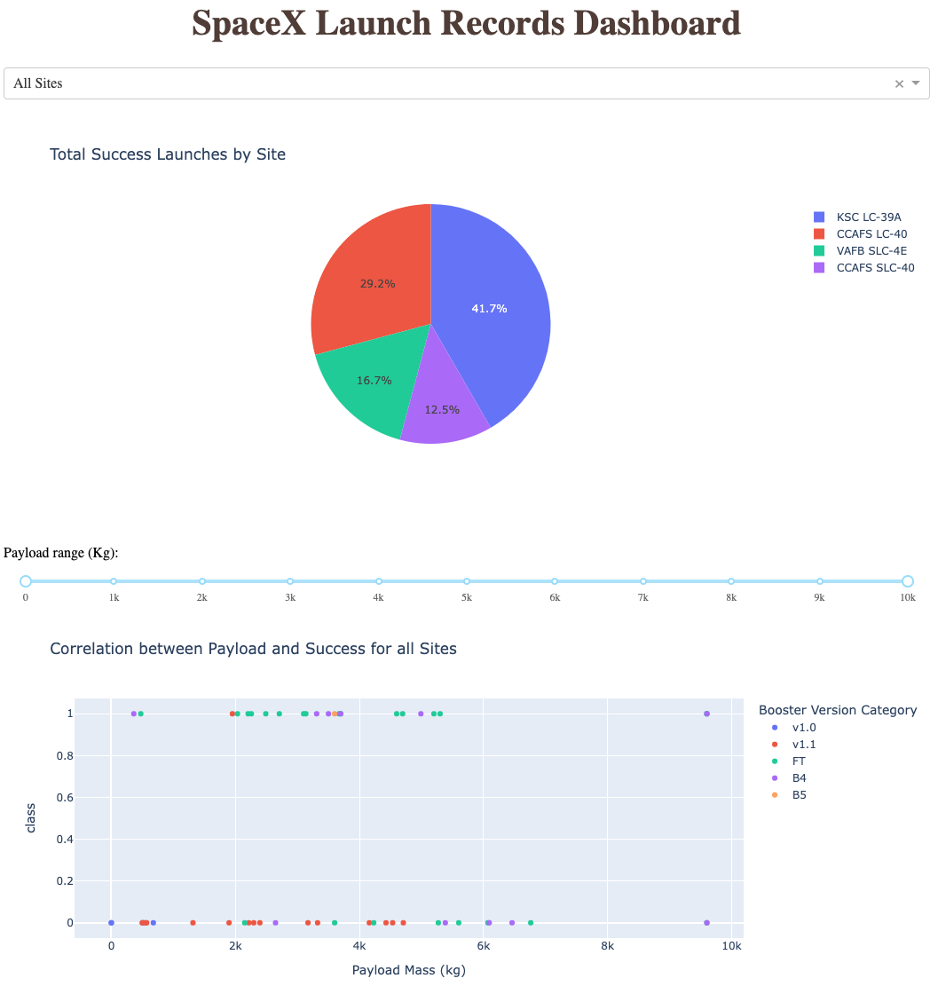
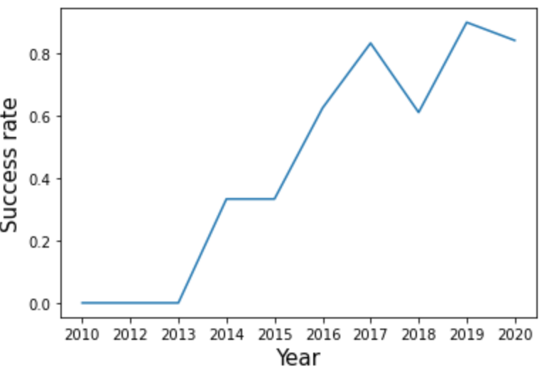
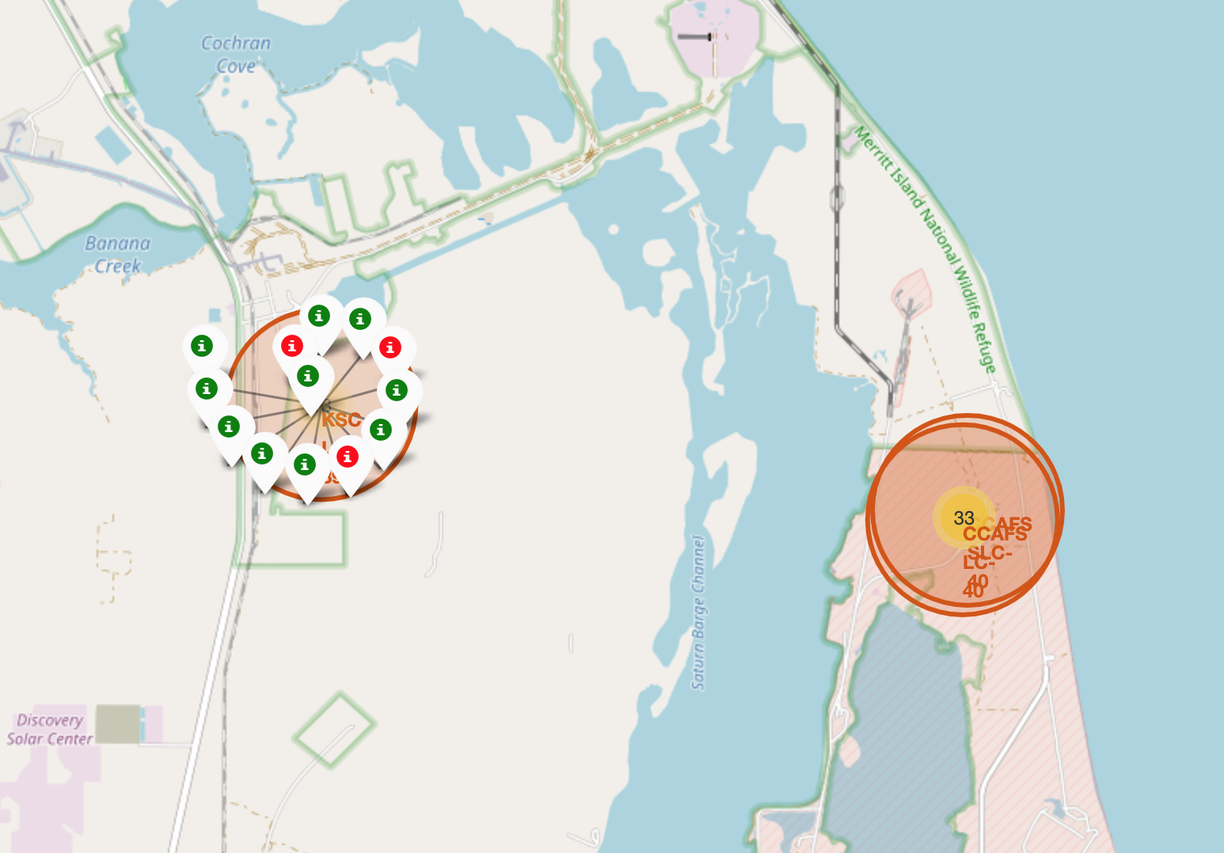
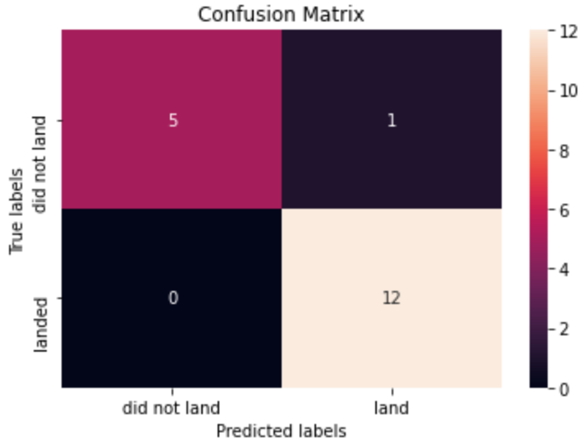
Results
Exploratory Data Analysis
• Launch success has improved over time
• KSC LC-39A has the highest success rate among landing sites
• Orbits ES-L1, GEO, HEO and SSO have a 100% success rate
Visual Analytics
• Most launch sites are near the equator, and all are close to the coast
• Launch sites are far enough away from anything a failed launch can damage (city, highway, railway), while still close enough to bring people and material to support launch activities
Predictive Analytics
• Decision Tree model is the best predictive model for the dataset

Slide 17

Section 2

Slide 18
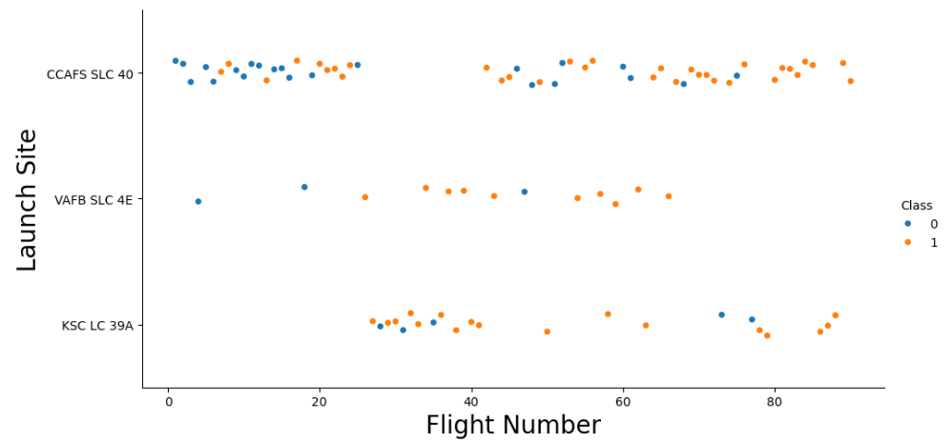
Flight Number vs. Launch Site
Exploratory Data Analysis:
Earlier flights had a lower success rate (blue = fail)
Later flights had a higher success rate (orange = success)
Around half of launches were from CCAFS SLC 40 launch site
VAFB SLC 4E and KSC LC 39A have higher success rates
We can infer that new launches have a higher success rate

Slide 19
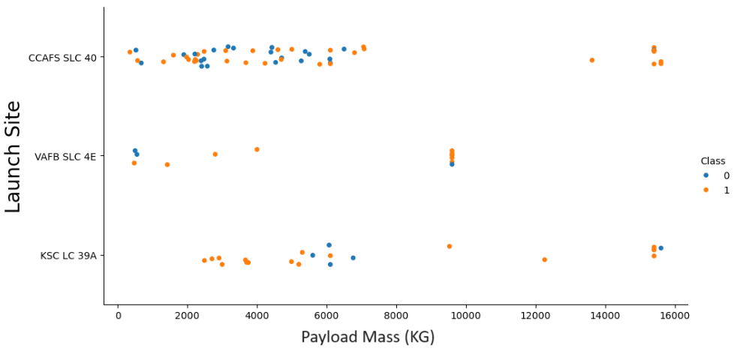
Payload vs. Launch Site
Exploratory Data Analysis
Typically, the higher the payload mass (kg), the higher the success rate
Most launces with a payload greater than 7,000 kg were successful
KSC LC 39A has a 100% success rate for launches less than 5,500 kg
VAFB SKC 4E has not launched anything greater than ~10,000 kg

Slide 20
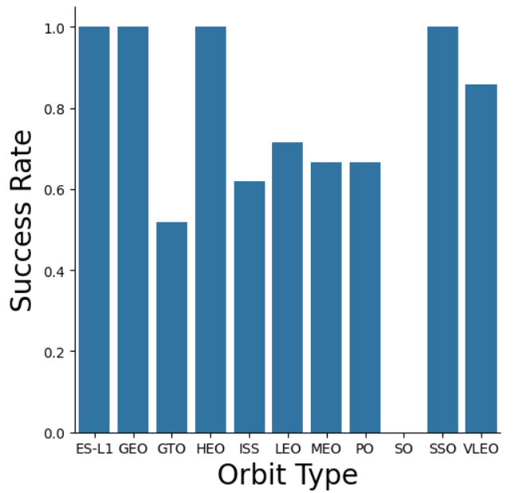
Success Rate vs. Orbit Type
Exploratory Data Analysis
100% Success Rate: ES-L1, GEO, HEO and SSO
50%-80% Success Rate: GTO, ISS, LEO, MEO, PO
0% Success Rate: SO

Slide 21
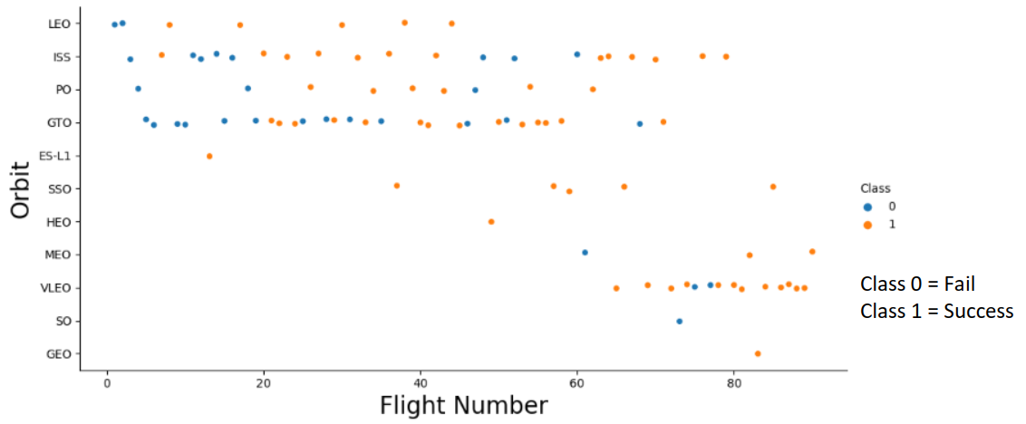
Flight Number vs. Orbit Type
Exploratory Data Analysis
The success rate typically increases with the number of flights for each orbit
This relationship is highly apparent for the LEO orbit
The GTO orbit, however, does not follow this trend

Slide 22
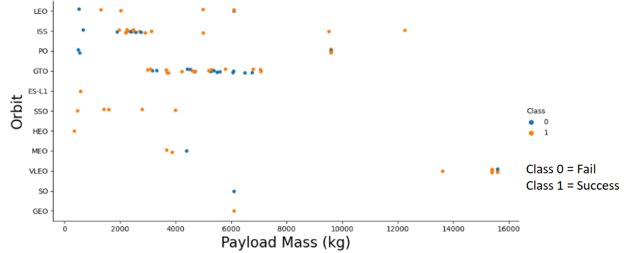
Payload vs. Orbit Type
Exploratory Data Analysis
Heavy payloads are better with LEO, ISS and PO orbits
The GTO orbit has mixed success with heavier payloads

Slide 23
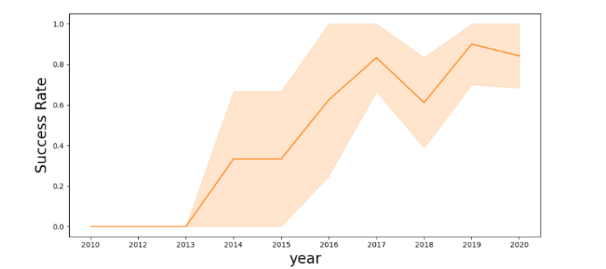
Launch Success Yearly Trend
Exploratory Data Analysis
The success rate improved from 2013-2017 and 2018-2019
The success rate decreased from 2017-2018 and from 2019-2020
Overall, the success rate has improved since 2013

Slide 24
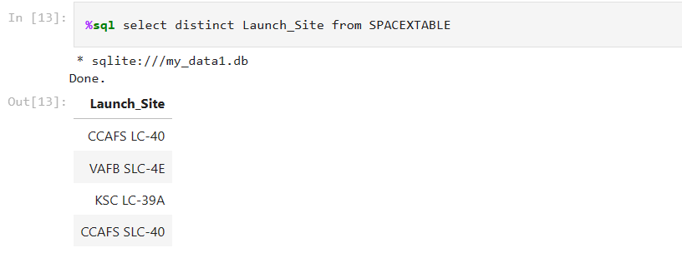
All Launch Site Names
Launch Site Names
CCAFS LC-40
CCAFS SLC-40
KSC LC-39A
VAFB SLC-4E

Slide 25
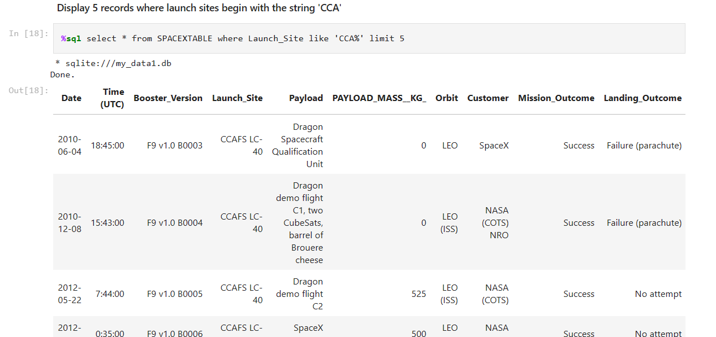
Launch Site Names Begin with 'CCA'
Launch Site Names begin with ‘CCA’
CCAFS LC-40
CCAFS SLC-40

Slide 26
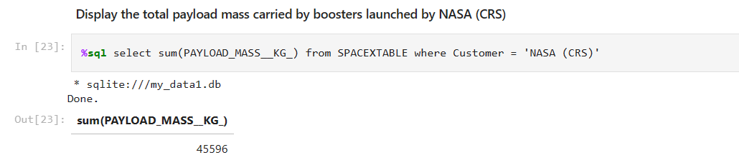
Total Payload Mass
Total Payload Mass
45,596 kg (total) carried by busters launched by NASA (CRS)

Slide 27
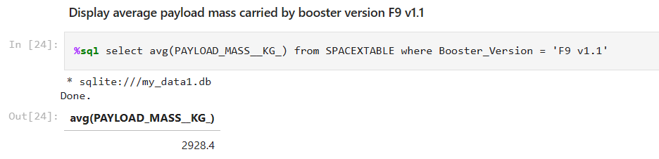
Average Payload Mass by F9 v1.1
Average Payload Mass
2,928 kg (average) carried by booster version F9 v1.1

Slide 28
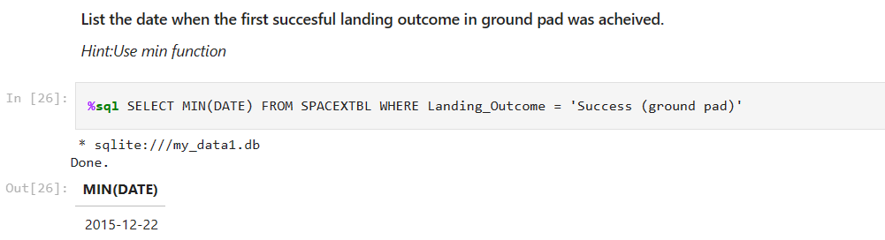
First Successful Ground Landing Date
1st Successful Landing in Ground Pad
12/22/2015

Slide 29
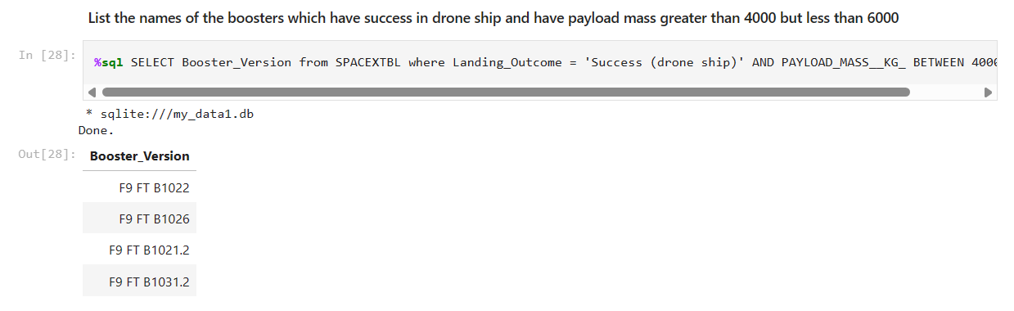
Successful Drone Ship Landing with Payload between 4000 and 6000
Explanation: names of boosters which have successfully landed on drone ship and had payload mass greater than 4000 but less than 6000
F9 FT B1022
F9 FT B1026
F9 FT B1021.2
F9 FT B1031.2

Slide 30
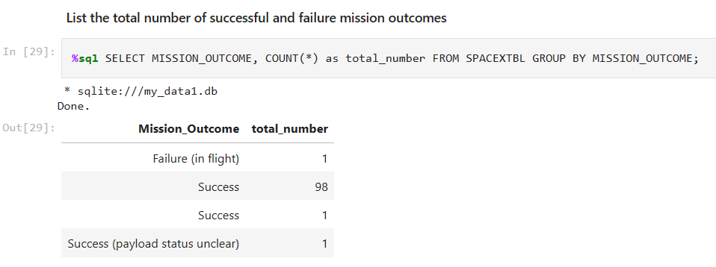
Total Number of Successful and Failure Mission Outcomes
Total Number of Successful and Failed Mission Outcomes
1 Failure in Flight
99 Success
1 Success (payload status unclear)

Slide 31
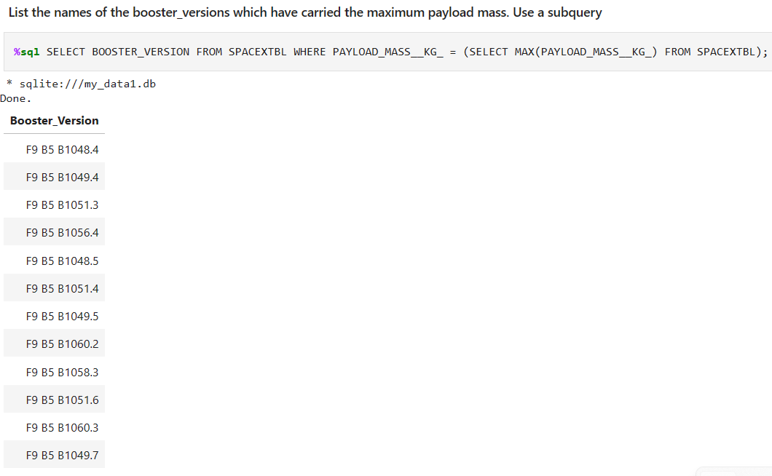
Boosters Carried Maximum Payload
Carrying Max Payload
F9 B5 B1048.4
F9 B5 B1049.4
F9 B5 B1051.3
F9 B5 B1056.4
F9 B5 B1048.5
F9 B5 B1051.4
F9 B5 B1049.5
F9 B5 B1060.2
F9 B5 B1058.3
F9 B5 B1051.6
F9 B5 B1060.3
F9 B5 B1049.7

Slide 32
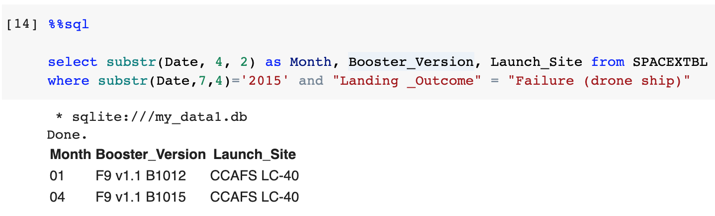
2015 Launch Records
2015 Launch Records
Month | Booster_Version | Launch_Site
01 | F9 v1.1 B1012 | CCAFS LC-40
04 | F9 v1.1 B1015 | CCAFS LC-40

Slide 33
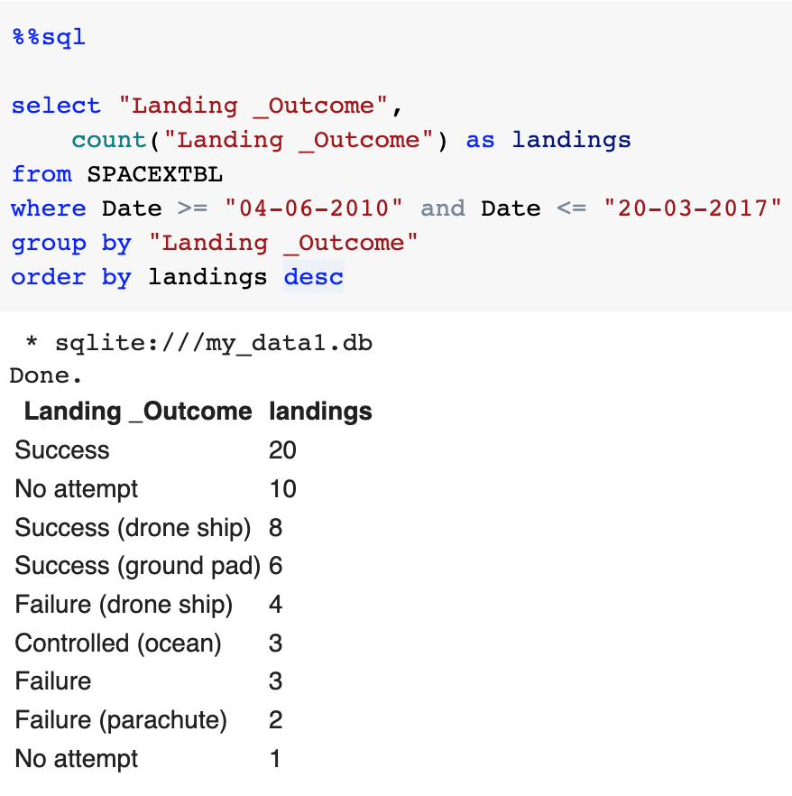
Rank Landing Outcomes Between 2010-06-04 and 2017-03-20
Landing _Outcome | landings
Success | 20
No attempt | 10
Success (drone ship) | 8
Success (ground pad) | 6
Failure (drone ship) | 4
Controlled (ocean) | 3
Failure | 3
Failure (parachute) | 2
No attempt | 1

Slide 34

Section 3

Slide 35
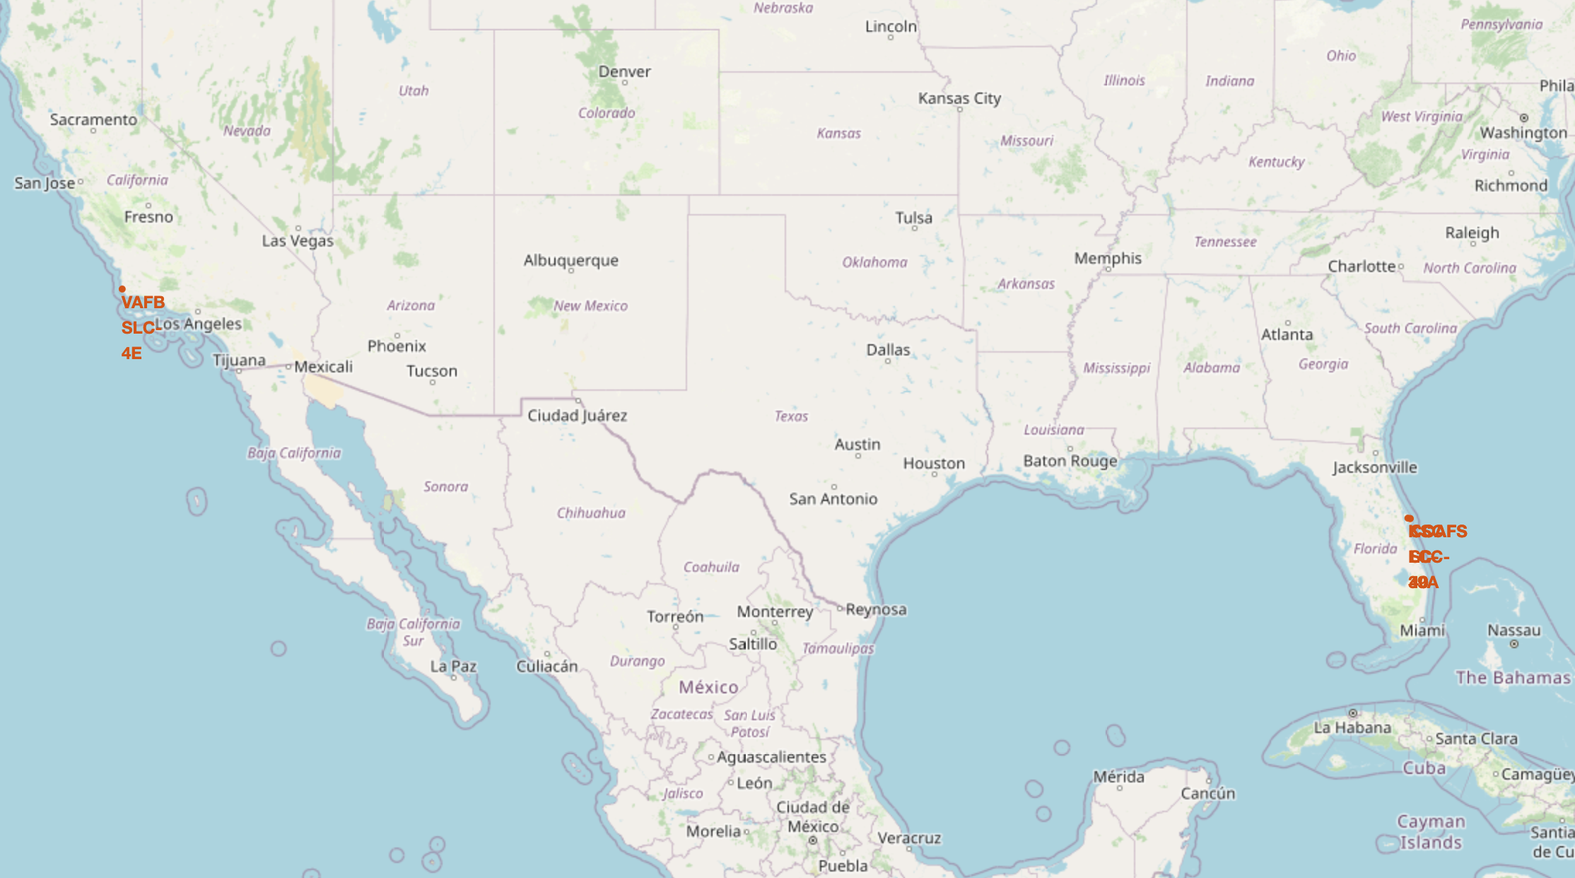
Locations of Launch Sites on Maps
Launch Site | Lat | Long
CCAFS LC-40 | 28.56230197 | -80.57735648
CCAFS SLC-40 | 28.56319718 | -80.57682003
KSC LC-39A | 28.57325457 | -80.64689529
VAFB SLC-4E | 34.63283416 | -120.6107455

Slide 36
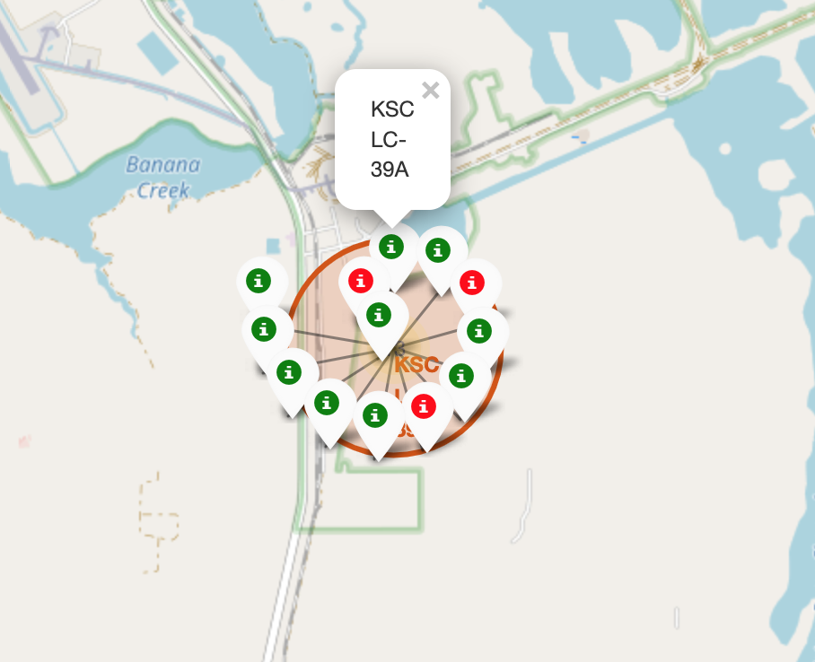
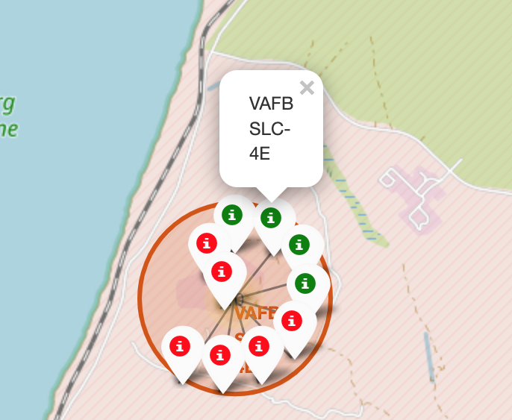
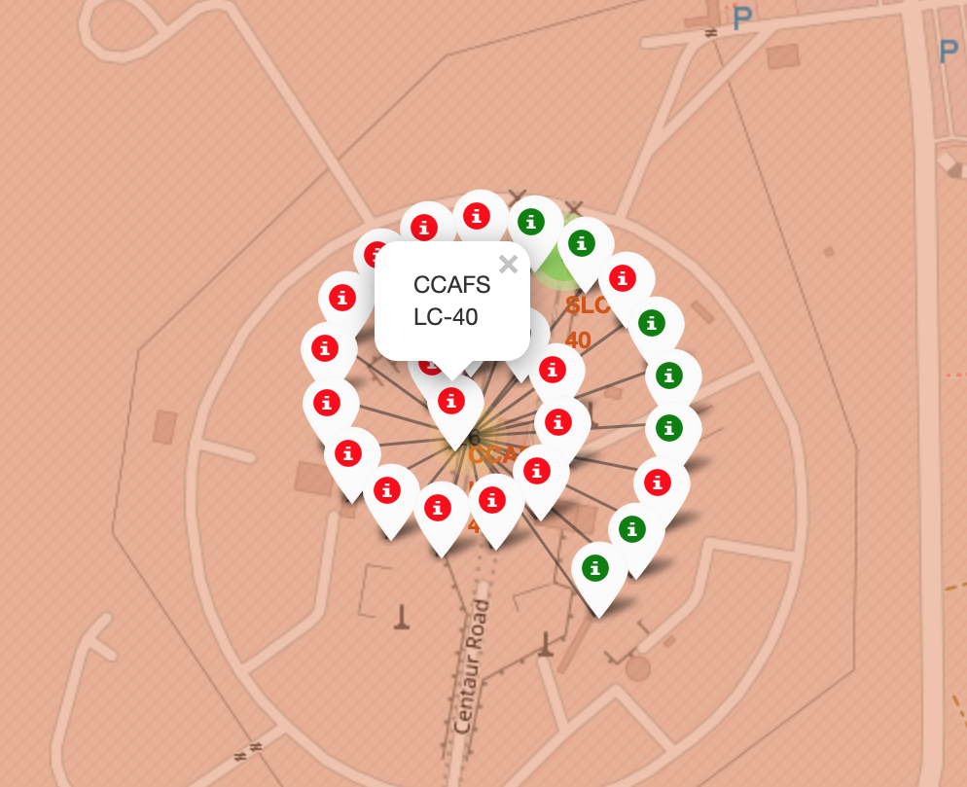
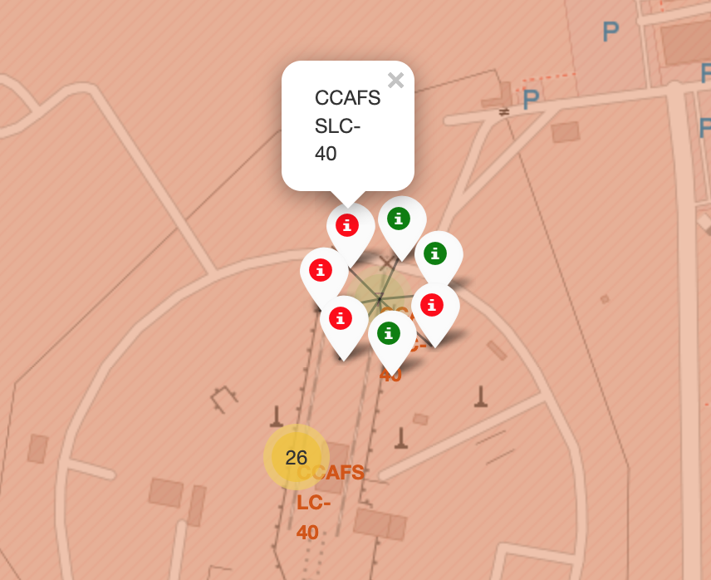
Display Launch Outcome by Color
From the color labels, we can easily see
KSC LC-39A has a rather higher success rate
Whereas CCAFS LC-40 and CCAFS SLC-40 have much lower rate

Slide 37
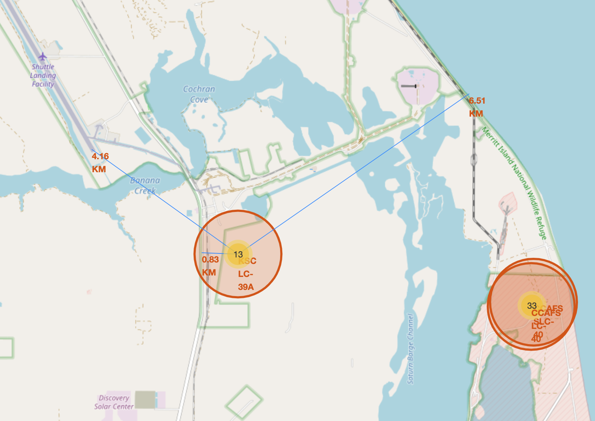
Show Distance to Proximities
The distance from KSC LC-39A to the nearest shuttle landing facility is about 4.16 km.
The distance from KSC LC-39A to the nearest highway is less than 1 km.
The distance from KSC LC-39A to the coastline is around 6.5 km.

Slide 38

Section 4

Slide 39
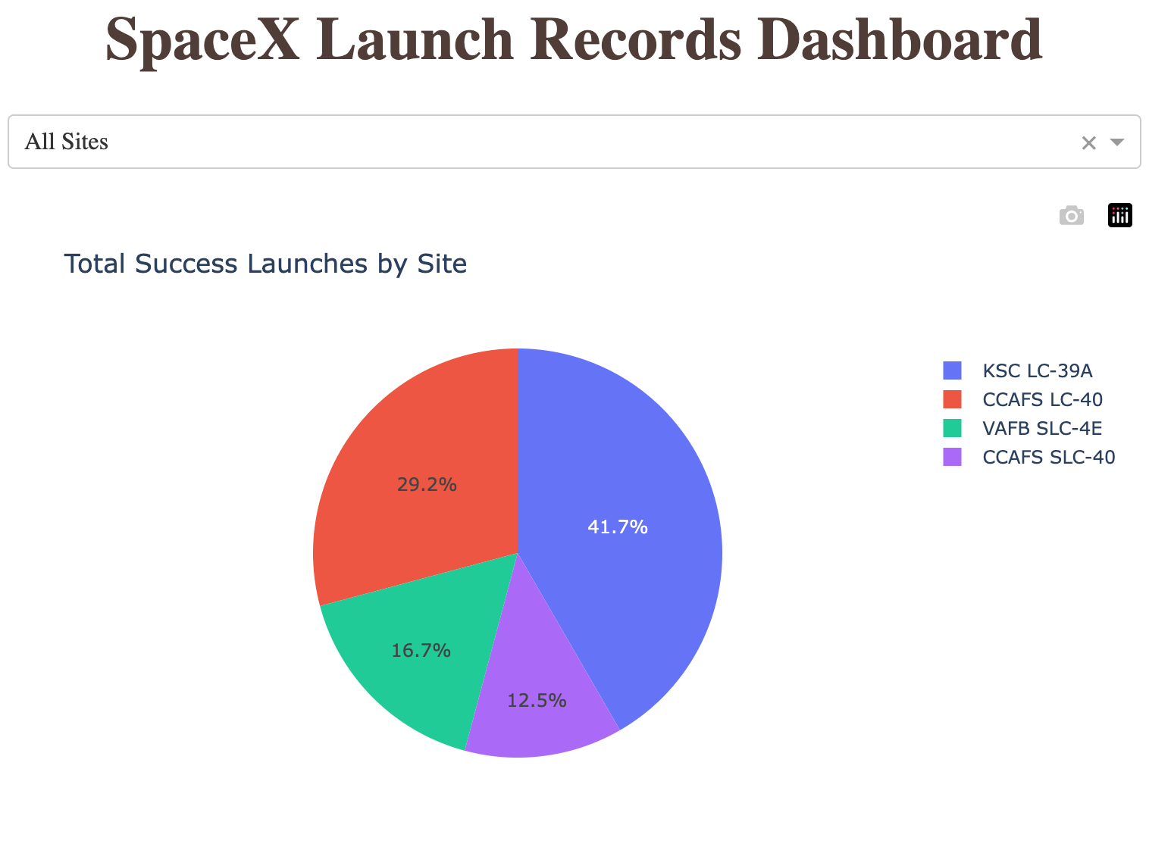
Total Success Launches for All Sites
Total Success Launches for All Sites is
CCAFS LC-40: 29.2%
VAFB SLC-4E: 16.7%
KSC LC-39A: 41.7%
CCAFS SLC-40: 12.5%

Slide 40
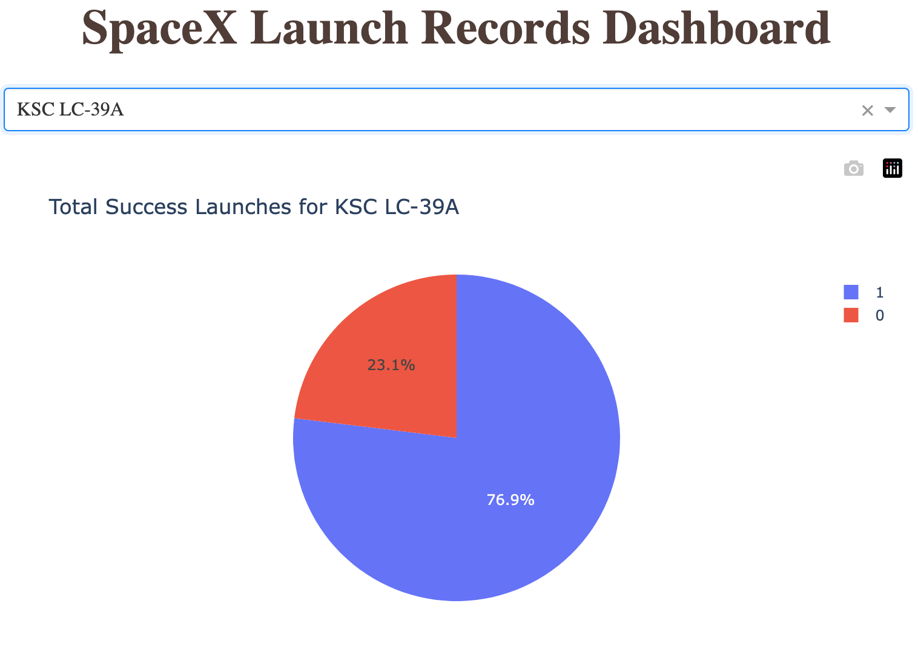
Success Ratio for KSC LC-39A
The launch site with highest launch success ratio is KSC LC-39A.
It has a success rate of 76.9%.

Slide 41
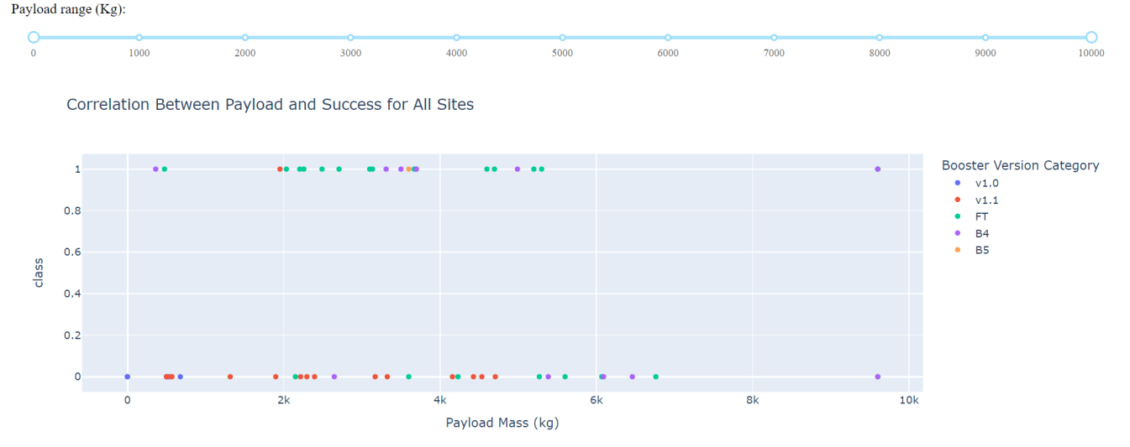
Payload Mass and Success
By Booster Version
Payloads between 2,000 kg and 5,000 kg have the highest success rate
1 indicating successful outcome and 0 indicating an unsuccessful outcome

Slide 42

Section 5

Slide 43
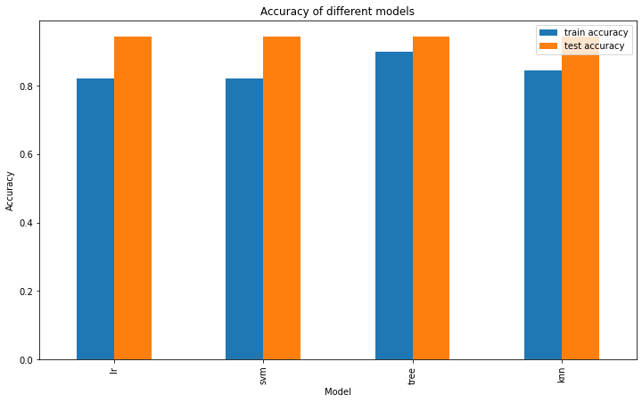
Classification Accuracy
Decision Tree model has the highest classification accuracy
Training accuracy 0.9, testing accuracy 0.94
Parameter: {'criterion': 'gini', 'max_depth': 8, 'max_features': 'auto', 'min_samples_leaf': 2, 'min_samples_split': 10, 'splitter': 'random'}

Slide 44
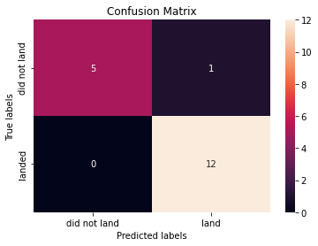
Confusion Matrix
Decision Tree model can distinguish between the different classes.
The major problem is false positives.

Slide 45
Conclusions
Model Performance: The models performed similarly on the test set with the decision tree model slightly outperforming
Equator: Most of the launch sites are near the equator for an additional natural boost - due to the rotational speed of earth - which helps save the cost of putting in extra fuel and boosters
Coast: All the launch sites are close to the coast
Launch Success: Increases over time
KSC LC-39A: Has the highest success rate among launch sites. Has a 100% success rate for launches less than 5,500 kg
Orbits: ES-L1, GEO, HEO, and SSO have a 100% success rate
Payload Mass: Across all launch sites, the higher the payload mass (kg), the higher the success rate

Slide 46
Appendix
My Github repo for the project
https://github.com/saturn-sam/IBM_Data_Science/tree/b0a38417a03b0e22d0f37db279deacf6b7c46b6b/C10

Slide 47


